Slide 1

Epic Monopoly
PROPOSAL REPORT
李子强
毛玉莲
倪犀子
郑艺林
周宸宇

Slide 2





Motivation
Solution & Silver Bullet
UML & Methodology

Slide 3

1
Motivation

Slide 4

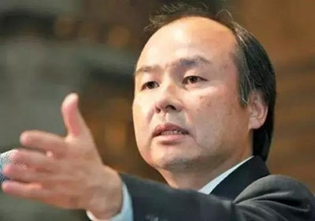




Current Problem

Slide 5

Current Problem
Static
Unreality
Constant
Noncooperation

Slide 6

2
Solution
&
Silver Bullet

Slide 7

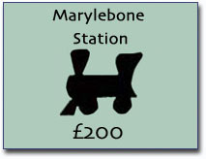

Economy Factor
EF

Slide 8
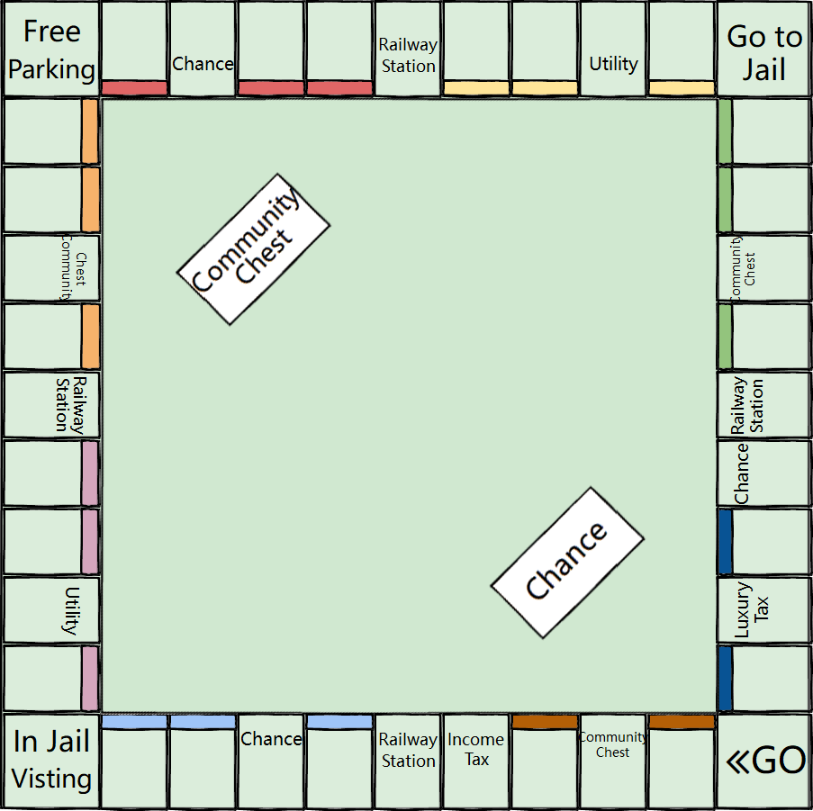
Dynamic Map
Real state color blocks
Station & Utility
Functional Spot

Slide 9
Country & Alliance
Discount
Asia
Asia
New event
China
India
Tax rate: 10%
Tax rate: 20%

Slide 10
Difficulty Setting
15%
Fluctuation EF
10%
5%
Initial Cash
Custom Config.

Slide 11

Add Enterpriser
50%
Enterpriser

Slide 12

Chessboard

Slide 13
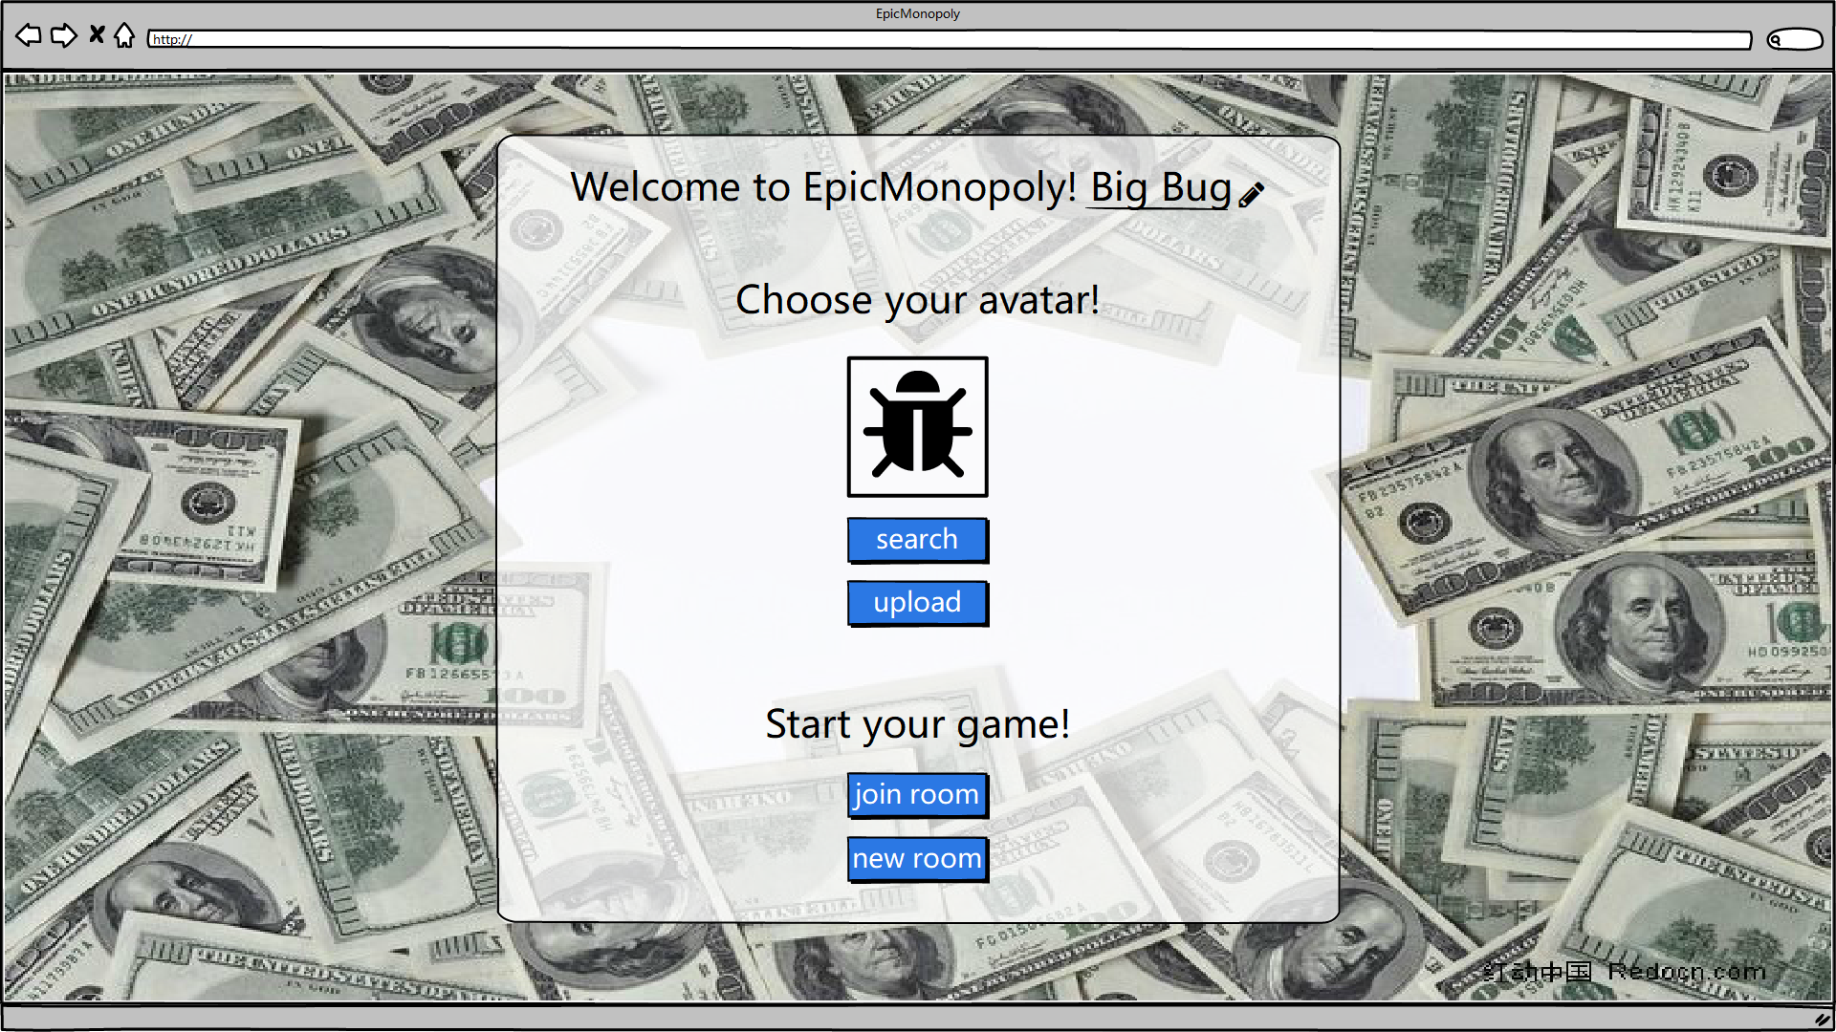
Welcome Page

Slide 14
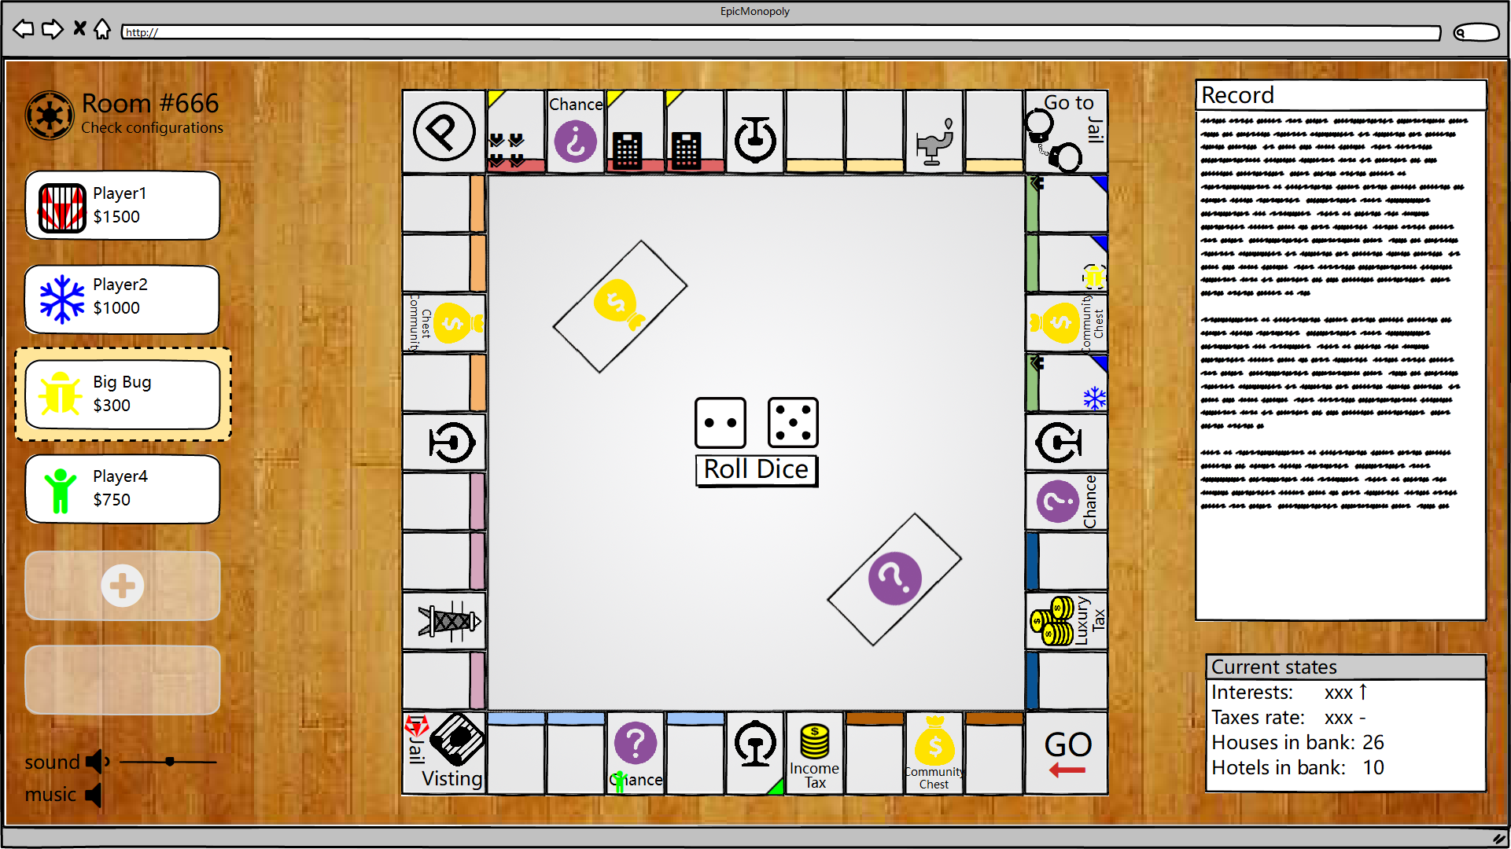
In Game

Slide 15
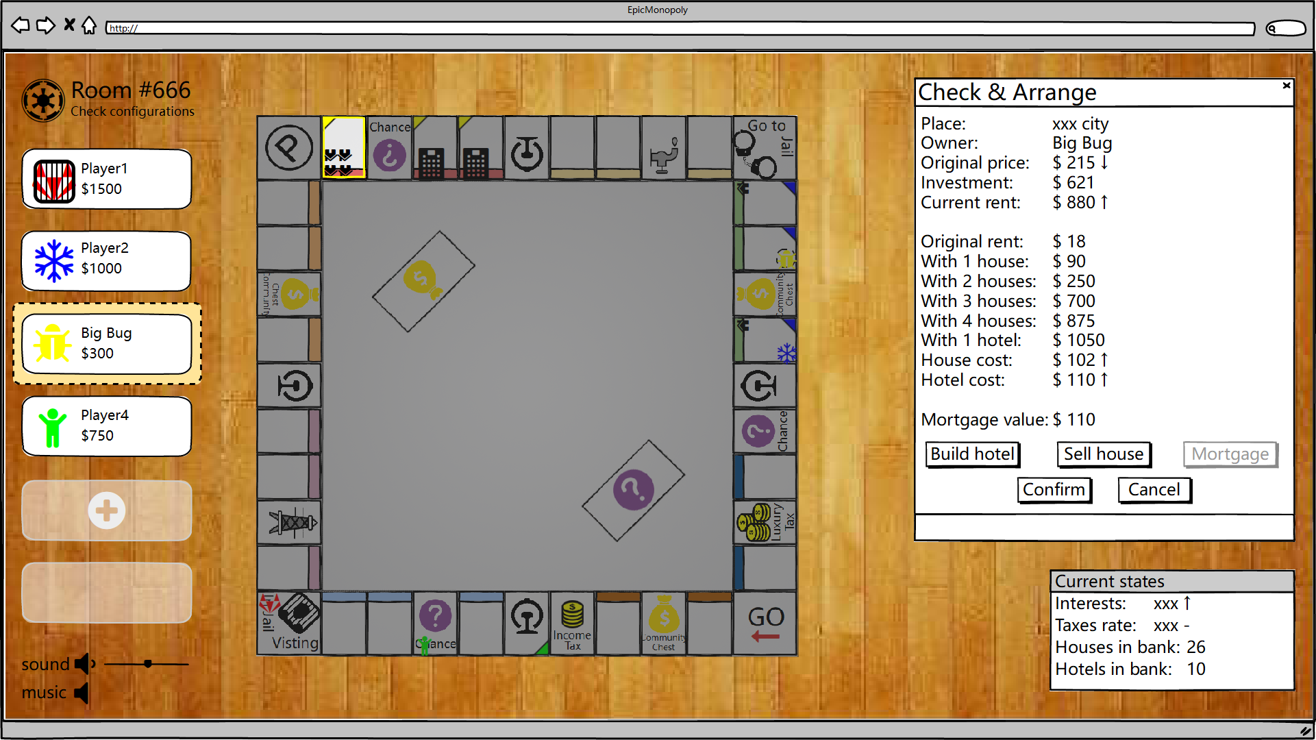
Check & Arrange

Slide 16
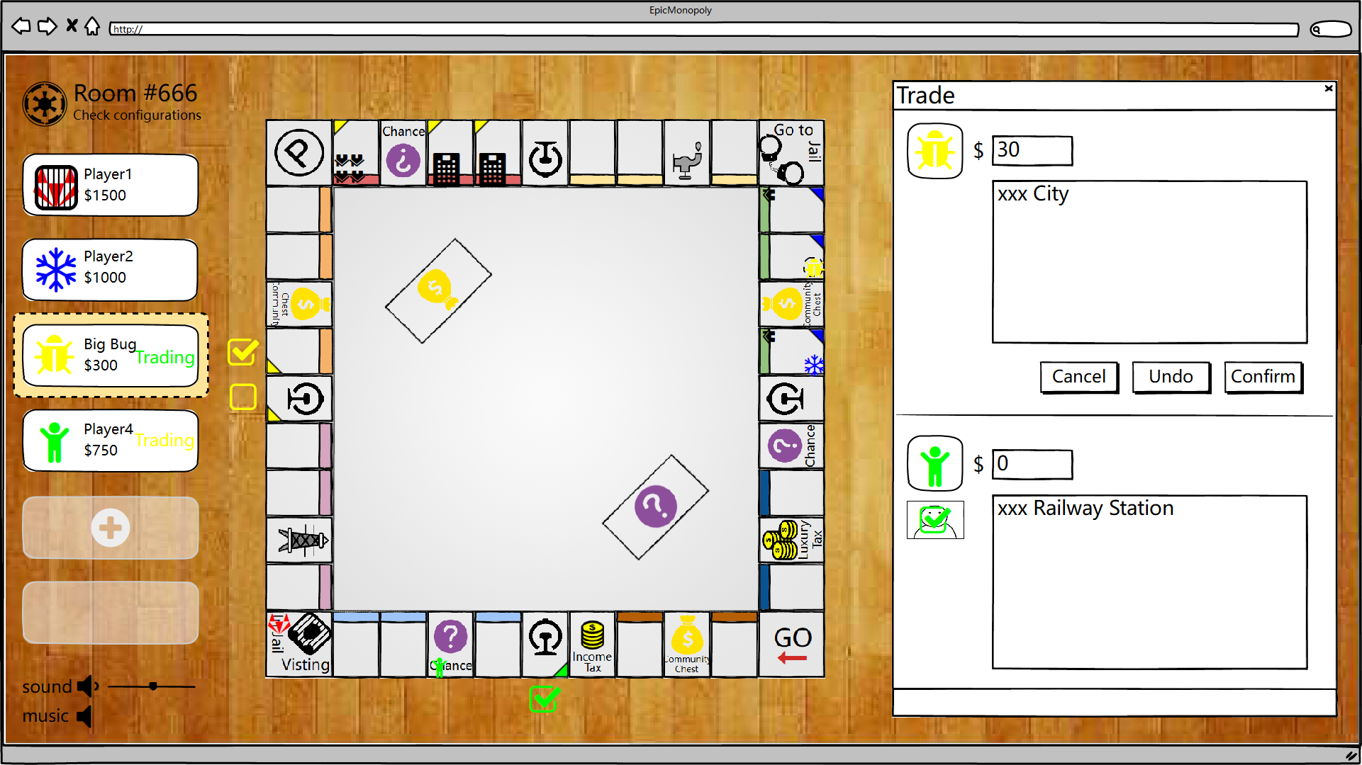
Trade With Others

Slide 17

3
UML
&
Methodology

Slide 18
UML State Chart

Slide 19
UML Class Diagram
Role

Slide 20
UML Class Diagram
Card

Slide 21
UML Class Diagram
Room

Slide 22
UML Class Diagram
Property
Map

Slide 23
UML Class Diagram

Slide 24
Technique
Client
Server
UI
Architecture: End of Oct
Coding: Middle of Nov.
Test: Middle of Dec.
Technologies
Testing plan
Architecture
Framework
Framework
Timeline
Ajax
Bootstrap
Database
JQuery
Node.js
Django/tornado
Unit test
Integration test
System test
Acceptance test

Slide 25
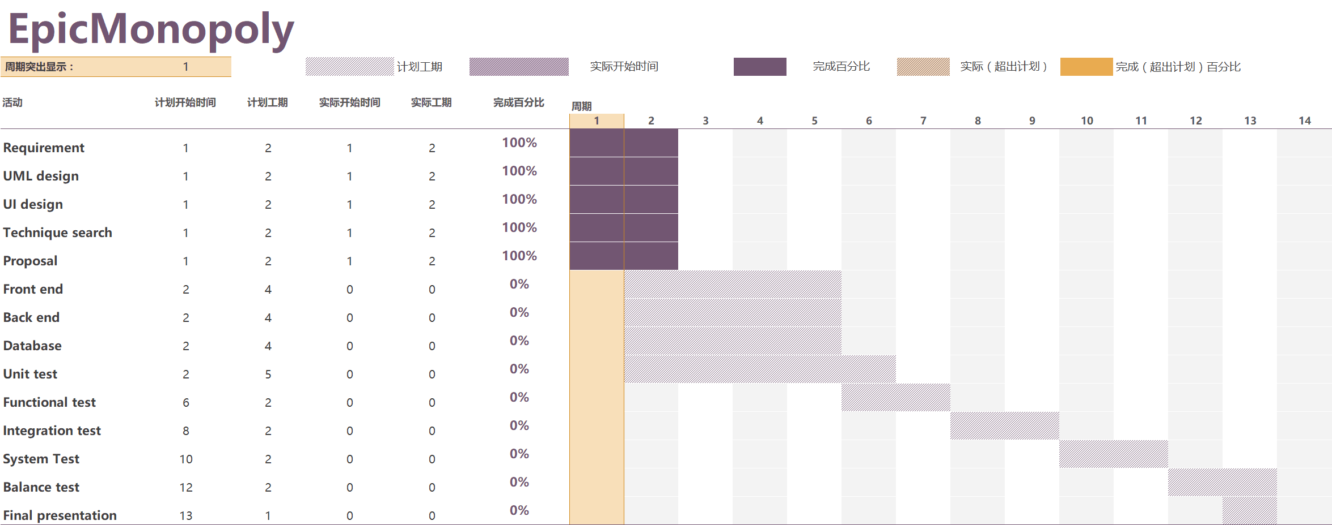
TimeLine

Slide 26
Q & A
Thank you!

